Slide 1
Final Project: Genomics
COP-2220C
Instructor: Brian Williamson

Slide 2
Project Description
The human genome is available online as several large text files separated by chromosome.
Inside the files are ASCII characters
a,A,c,C,t,T,g,G are used to represented DNA.
Simple string search functions can be used to search the genome.
From #include <string.h>
strcmp(string1, string2)
Compares two strings
Returns 0 if the strings are equal.
strstr(haystack, needle)
Search a larger string (haystack) for a substring (needle).
Returns 0 if the needle is not found within the haystack.

Slide 3
The ALU Element
This is a sequence of DNA that is transposable.
It can move around within the DNA of a cell.
For example: during reverse transcription (RNA back to DNA)
The ALU element is the most abundant of the transposable elements in the human genome.
Is unique to primates.
Might be useful in gene expression.
That is they control whether a gene is expressed within a cell or not.
It is possible that the majority of your DNA is about gene expression rather than functional genes.
In 2015 it was found that humans share 70% of the genes with worms.

Slide 4
Why is the ALU Element Worth Studying?
Wikipedia lists the following diseases as linked to the ALU gene:
Alport syndrome
Breast cancer
Chorioretinal Degeneration
Ewing's sarcoma
Familial hypercholesterolemia
Hemophilia
Leigh syndrome
Mucopolysaccharidosis VII
Neurofibromatosis
Diabetes mellitus type II
Alzheimer's disease
Lung cancer
Gastric cancer

Slide 5
Project
You will write code to search the Genome for a particular variant of the ALU element.
Output for each chromosome:
Say the element was seen to begin at indices:
0, 1610, 8171, 121110, 232111, 311410, 398070
Number of times ALU element was seen
7 times
Median Index of ALU element
121110
Histogram (5 bins)
This is the number of times per bin

Slide 6
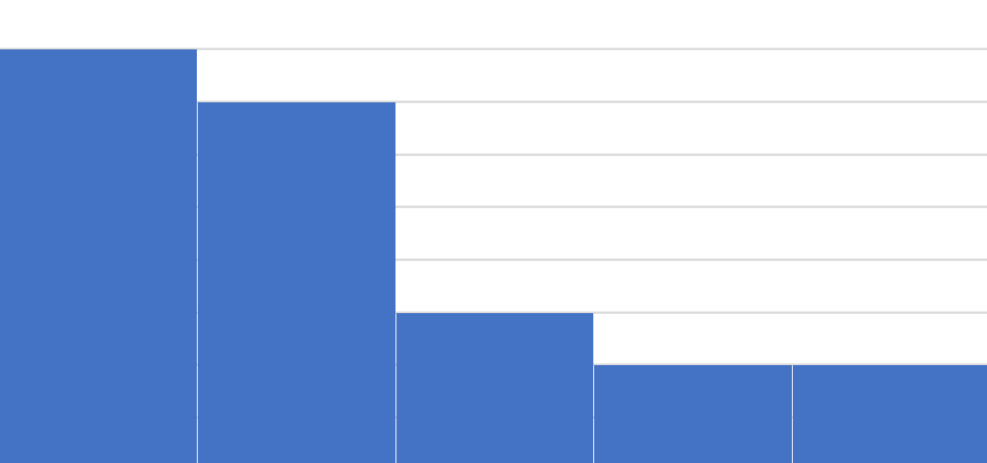
Histogram Notes
A histogram first determines a range for each bin.
Returns the count of how many times something occurred for each bin.
Range = (max – min)
Width = Range / N
Bin1 Range = min to (Width-1)
Bin2 Range = (Width) to (2*Width-1)
Bin3 Range = (2*Width) to (3*Width-1)
……
Produces a chart similar to….

Slide 7
Histogram Example
Say Chromosome 1 has 50,000 characters
10 bins and ALU element at:
1, 5001, 7002, 12131, 13211, 21110, 23220, 24121, 26911, 27622, 28220, 29991, 31330, 34213, 37181, 39121, 42311
Range = (50,000 – 0) = 50,000
Width = (50,000 / 5) = 10,000
Bin Number | Range | ALU Count
1 | 0 to 9999 | 3
2 | 10000 to 19999 | 2
3 | 20000 to 29999 | 7
4 | 30000 to 39999 | 4
5 | 40000 to 49999 | 1

Slide 8
What to Turn In
Your Code and Statistics (12/7/19)
Zip up your project and submit on Canvas.
Do NOT include the Genome.
Place your statistics into a Word document.
Can be screenshots pasted into a word document.

Slide 9
QUESTIONS?

